Slide 1
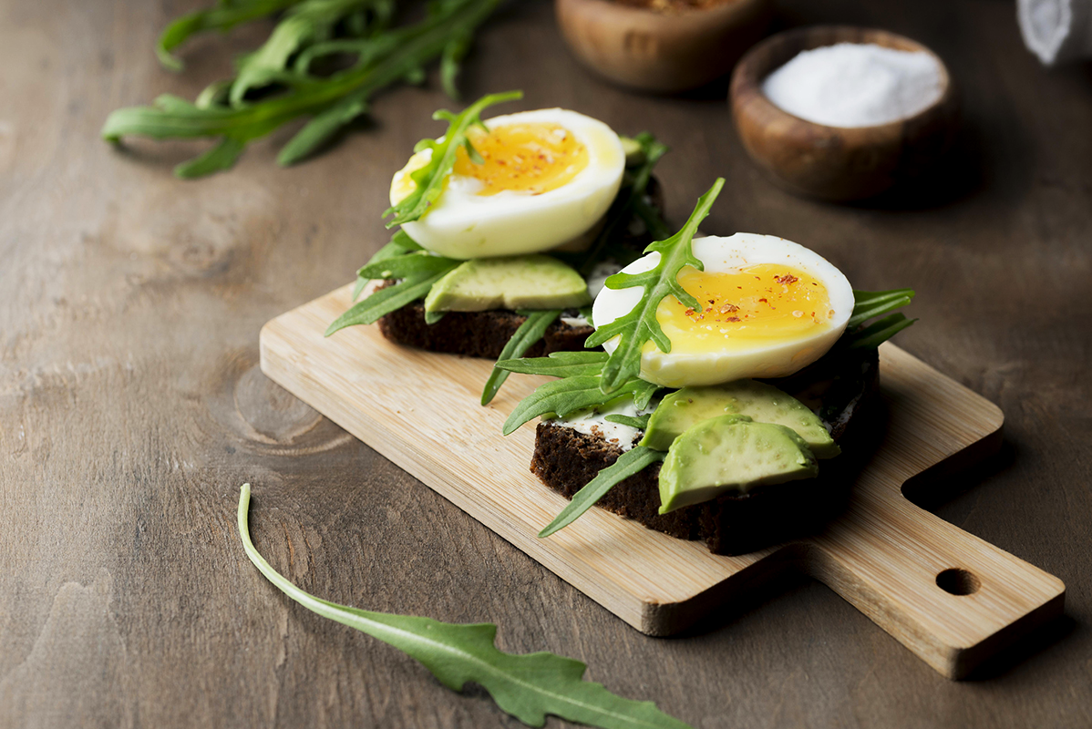
FOODAUC APP
GROUP 18
FINAL PROJECT PRESENTATION

Slide 2
AGENDA
CHAPTER 1
CHAPTER 2
CHAPTER 3
GENERAL INTRODUCTION
LITERATURE REVIEW
ANALYSIS AND DESIGN
CHAPTER 4
CHAPTER 5
IMPLEMENTATION AND RESULTS
CONCLUSION AND FURTHER WORKS

Slide 3
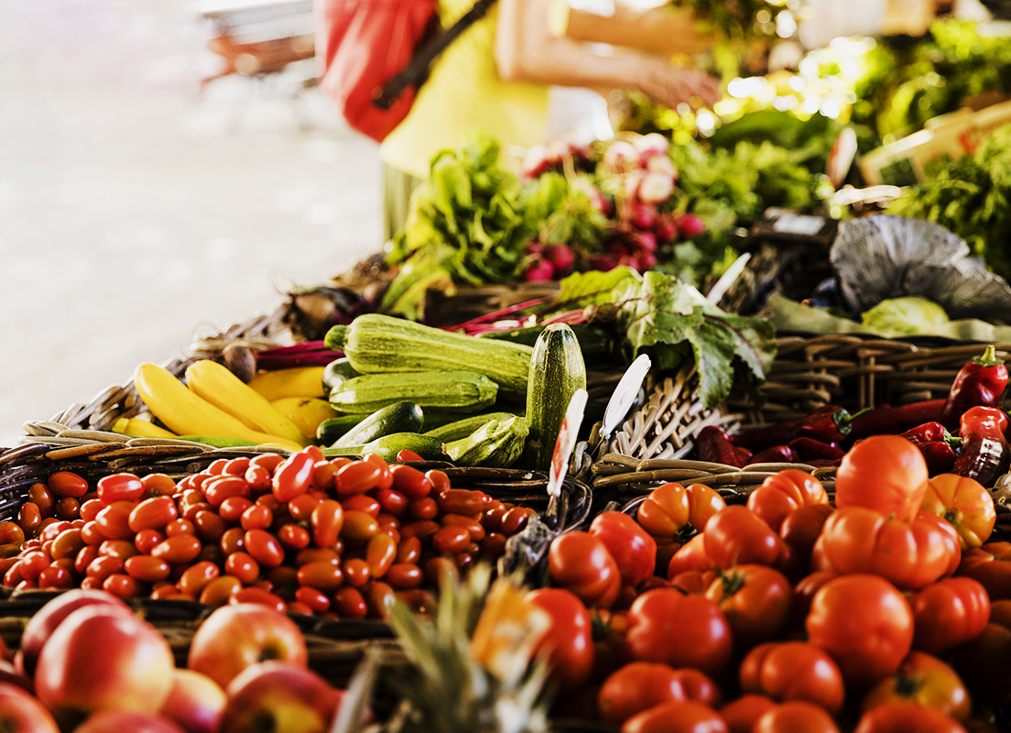
CHAPTER 1
GENERAL INTRODUCTION

Slide 4
01
BACKGROUND AND CONTEXT OF THE STUDY
Internet programming refers to creating a software that runs on the internet. This involves developing web applications that can be accessed through a web browser or mobile device. Mobile programming refers to creating software applications that can run on mobile devices such as smartphones and tablets. It can be done for different operating systems such as Android and IOS.

Slide 5
01
PROBLEM STATEMENT
The system works by providing a platform for people to upload foodstuff which they no longer need for free or at reduced prices and enabling people who are in need of food to search for available food, thereby reducing the waste of food.

Slide 6
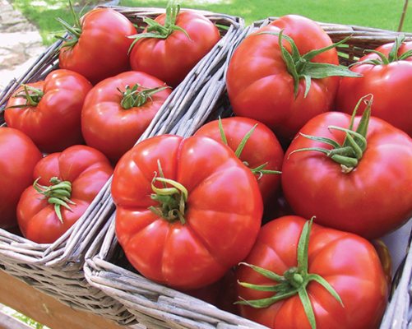
01
OBJECTIVES OF THE STUDY
GENERAL OBJECTIVE
This study aims to create a platform which in an efficient way connects people who have excess food and are willing to give it out free or at a reduced price and consumers who are in need of food and are willing to take this food Thereby reducing food waste as excess or unsold food is redirected to consumers who need it.

Slide 7
01
PROPOSED METHODOLOGY
The methodology for designing and implementing a food waste management system is iterative as the development team will revisit earlier steps as necessary based on feedback and changes in requirements.This may include the following steps;
Requirement Gathering
Analysis and planning
Design and prototyping:
Development and testing
User acceptance testing
Maintenance and support

Slide 8
01
SCOPE OF THE STUDY
This refers to the extent and limitations of the project, including the specific focus of the study, the target audience and research objectives. It helps to ensure that the research is focused, feasible and relevant to the intended audience. The scope of this project includes;
- Food types
- Geographic scope:
- Technical scope
-Business scope

Slide 9
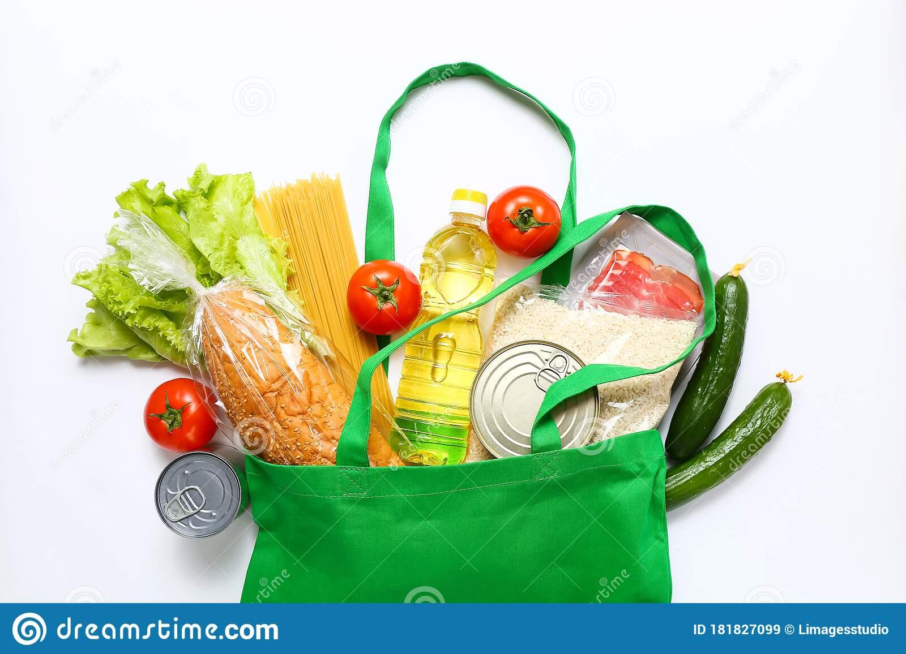
CHAPTER 2
LITERATURE REVIEW

Slide 10

02
DIFFERENT MOBILE APPLICATIONS
NATIVE APPS
Native apps are built for a dedicated operating system on a device. For example Android apps and iOS apps
WEB APPS
Web apps behave similarly to native apps but are accessed via a web browser on your mobile device
HYBRID APPS
They’re really web apps made to look native.

Slide 11
02
2. REVIEW ON THE DIFFERENT PROGRAMMING LANGUAGES
FOR iOS
Objective-C & Swift
These are the key languages for writing iOS apps. They are object-oriented. Besides, you may also apply:
C#
HTML5
Java

Slide 12
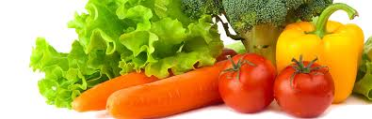
02
B. FOR ANDROID
Python
Android developers who write mobile apps in the Python programming language are rare, but still, they do exist and have great Support from the huge programming community.
C / C ++
C languages are positioned as high-performance languages, and this is important, especially if we are talking about something heavy like a mobile 3D game.
Java
It often takes the highest places in the popularity ratings (2nd place in the IEEE Spectrum (2020) ratings, and on TIOBE (2021) alongside Python.

Slide 13
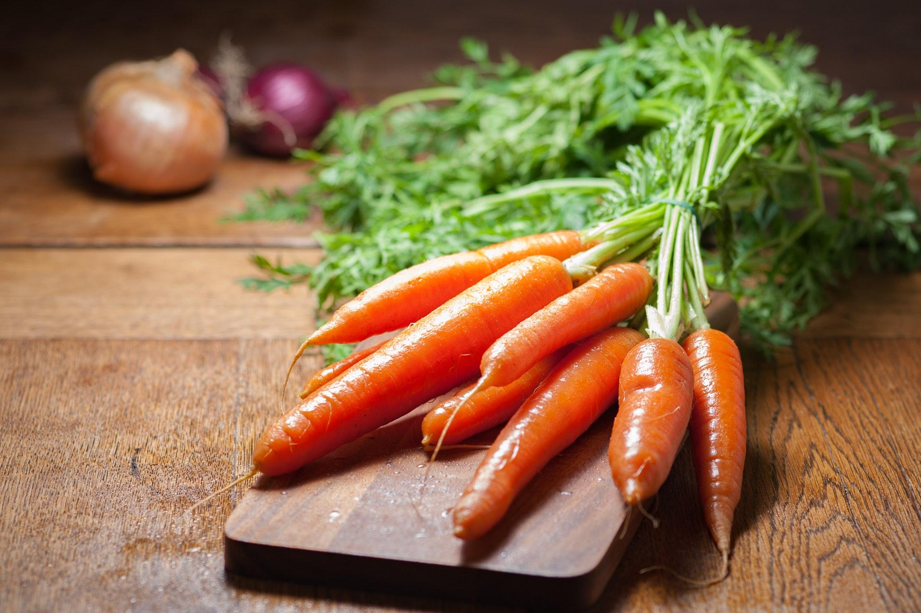
02
C. FOR WEB APPS
Scala
Scala combines object-oriented and functional programming in one concise, high-level language. Scala’s static types help avoid bugs in really complex applications.
JavaScript
This one is an interface language used for creating and developing websites, desktop applications, and games. JavaScript works in all browsers and can work with programs that are not hosted on the Internet.

Slide 14

02
3. REVIEW OF MOBILE APP DEVELOPMENT FRAMEWORKS
A mobile app development framework is a software framework that allows mobile app developers to build their applications.
Benefits of working within these rule-based templates or frameworks, it means developers are restricted in a way that helps them avoid making time-consuming programming errors so they can work faster and more efficiently.

Slide 15
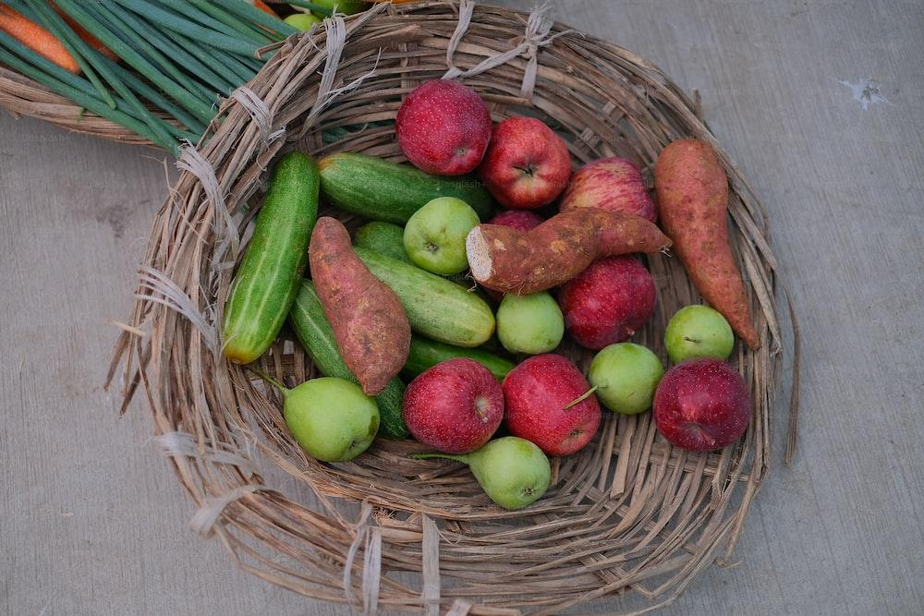
02
FLUTTER MOBILE APP DEVELOPMENT FRAMEWORK
Created by Google, it is a completely free and open-source mobile UI framework.
Benefits
- It is easier to use
- Flutter allows you to create an Android and IOS application with one codebase.
XAMARIN MOBILE APP DEVELOPMENT FRAMEWORK
XAMARIN is an open source framework created by Microsoft for development of native and good-performance Android and iOS apps.
Benefits
-Xamarin provides one code for all platforms.
- Its performance is improved daily

Slide 16
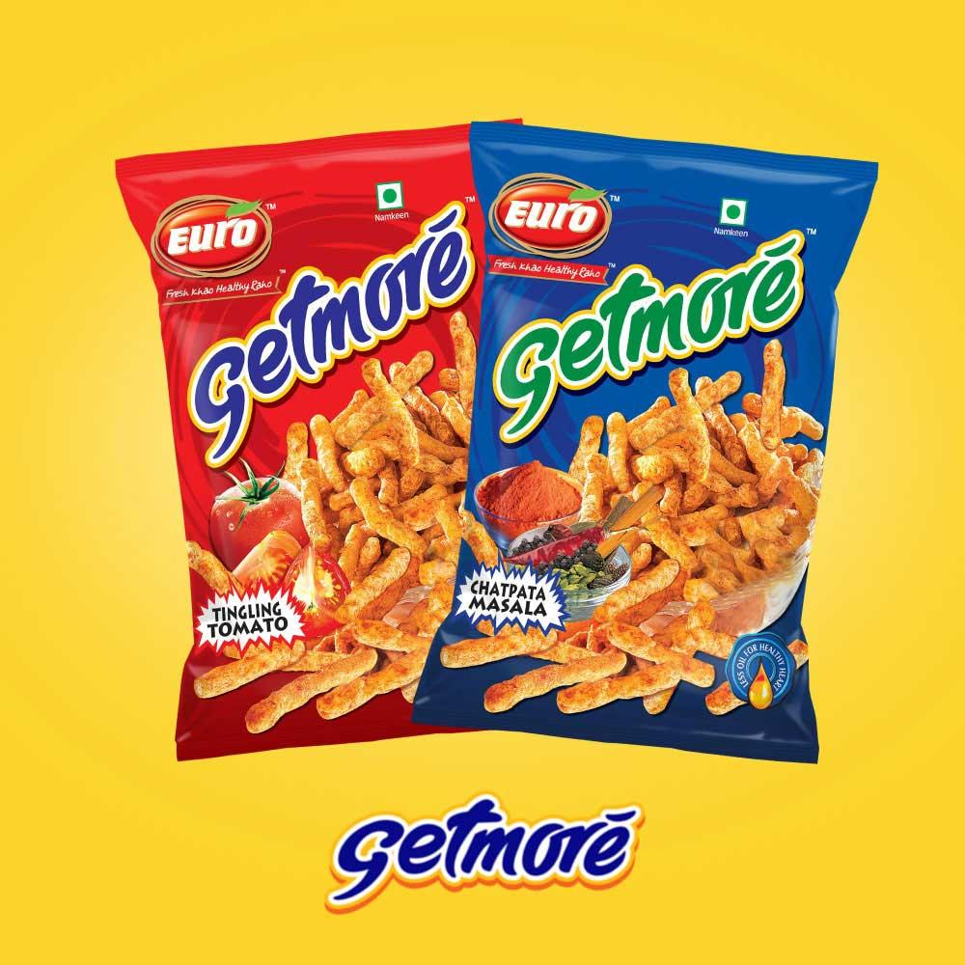
02
c. IONIC MOBILE APP DEVELOPMENT FRAMEWORK
Ionic is an open-source framework that allows developers to build iOS and Android apps for flawless mobile performance.
Benefits
- It is great for beginners because it allows you to create mobile applications if you know HTML, CSS, and JavaScript.
d. REACT NATIVE MOBILE APP DEVELOPMENT FRAMEWORK
React Native is an open source mobile app development javascript framework created by Facebook.
Benefits
-one codebase to share it on Android and iOS.
- It is efficient and cost less

Slide 17
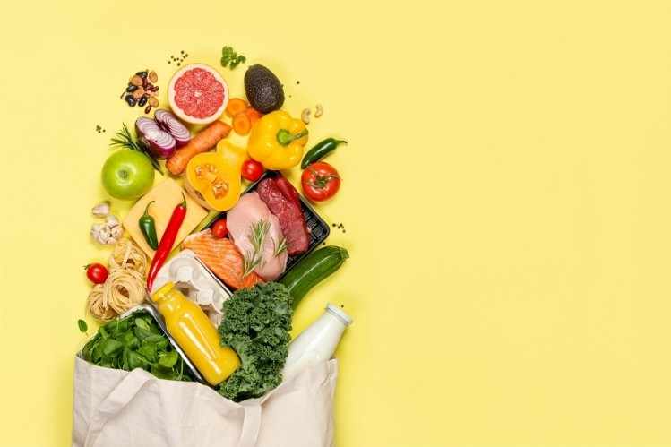
02
e. APACHE CORDOVA MOBILE APP DEVELOPMENT FRAMEWORK
It is one of the best develop-friendly app development frameworks and uses CSS3, JavaScript, and HTML5.
Benefits
- It makes Hybrid development easy and super fun.
- it lets you write native plugins that work with all supported platforms
f. NATIVE SCRIPTS
It is an open-source framework to create native mobile applications empowered with Angular, Typescript, JavaScript, CSS, and Vue.js.
Benefits
- Full direct access to Android & iOS APIs

Slide 18
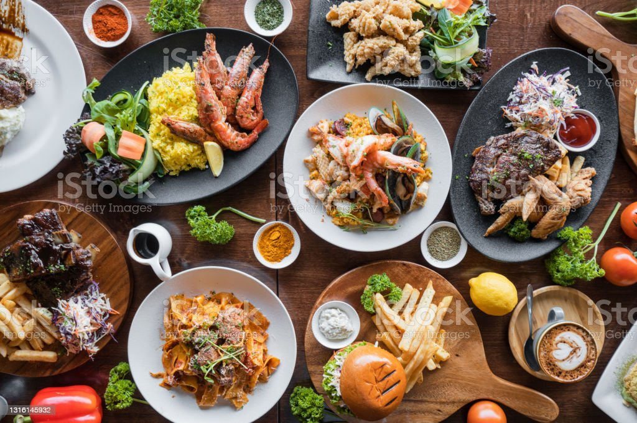
CHAPTER 3
ANALYSIS AND DESIGN

Slide 19
03
INTRODUCTION
The analysis and design of a food auction system involves a systematic approach to understanding the needs and requirements of the system, and developing a solution that meets those needs.
1
PROPOSED METHODOLOGY
In order to realize this project, the agile methodology was used.

Slide 20
03
3- ANALYSIS
In the analysis phase of this project, several aspects could be discussed which includes;
SOFTWARE REQUIREMENTS
The technologies used for this application are java, SQL and firebase
The installation and setup was done using Android studios, canvas and starUml

Slide 21
03
b- FUNCTIONAL REQUIREMENTS
Registration functionalities
Third-Party Integrations
Mobile-Friendliness
Product attributes
c- NON-FUNCTIONAL REQUIREMENTS
Usability
Security
Performance
Scalability

Slide 22
03
d- SYSTEM REQUIREMENTS
The system consists of three views: donor(Auction, charity), food_collector, Admin.
Each user should have an account.
Each use has a wallet account
Admins manage user data and transactions
Post food either for free or an auction price
They collect food stipulated agreements
e- USER REQUIREMENTS
Each and every user has ability to auction and take food on auction
Each user has an account
Each user can register to the application
Users can make collections
Users can exchange messages

Slide 23
03
f- DONOR FEATURES
Donors can make food donation advertisement on available food
Donors delete food donation post
Donors can make food donations free or open for minimum auctioning
Donors view collector profile
g- ADMIN FEATURES
Admins can delete food donation post
Admins can manage user data in database
Admins can view all the pending donations along with status.
Admins can view all the donations that they have received.
Admins can delete user account

Slide 24
03
h- COLLECTOR FEATURES
Collector will receive notifications from admins to collect food from donor's homes.
Collectors can mark their collection upon collection of food from the donor's home.
Collectors can recommend Donors.
Collectors can make food request

Slide 25
03
4- UML DESIGN

Slide 26
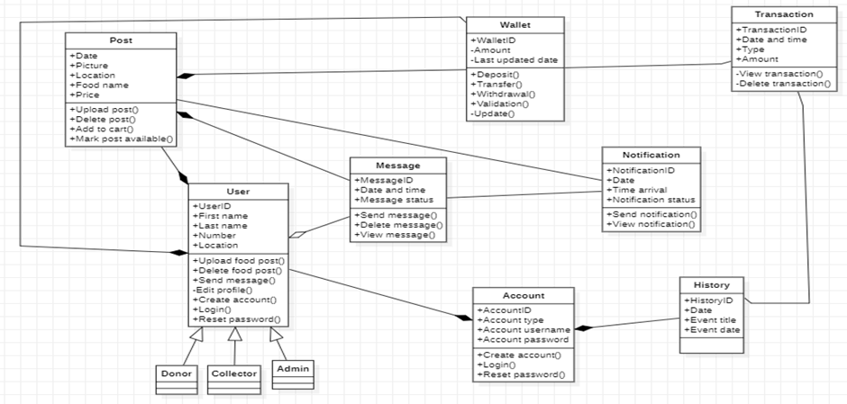
03
a- CLASS DIAGRAM
The class diagram below shows the connection and dependencies between the classes. The class diagram can be used to generate the ERD of the system.

Slide 27
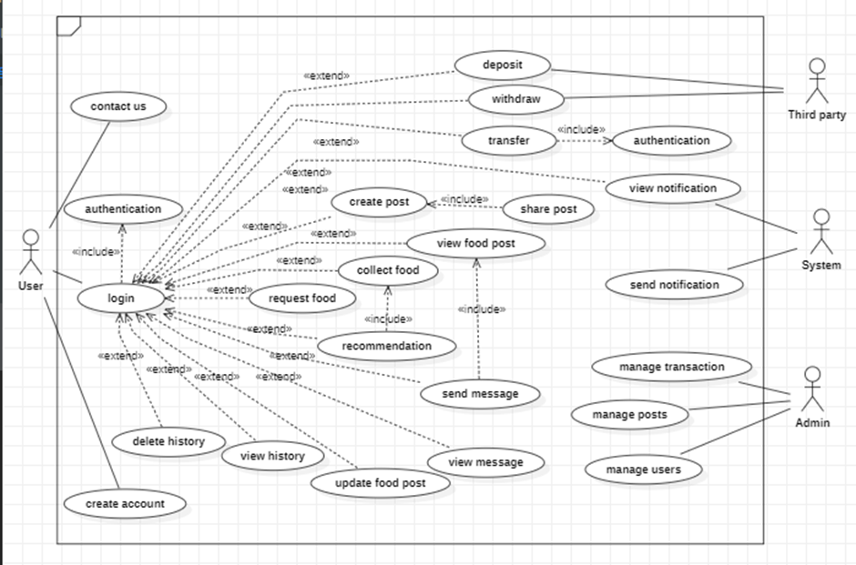
03
b- USE CASE DIAGRAM
The use cases represent the processes of our system. The various use cases are: Registration, Login, Logout, Forgot password, Create food post, Collect food post, Make deposit into wallet, Recommend Donor, Messaging(chat), Upload photo. The interaction between these use cases and their constraints is shown by the help of a use case diagram.

Slide 28
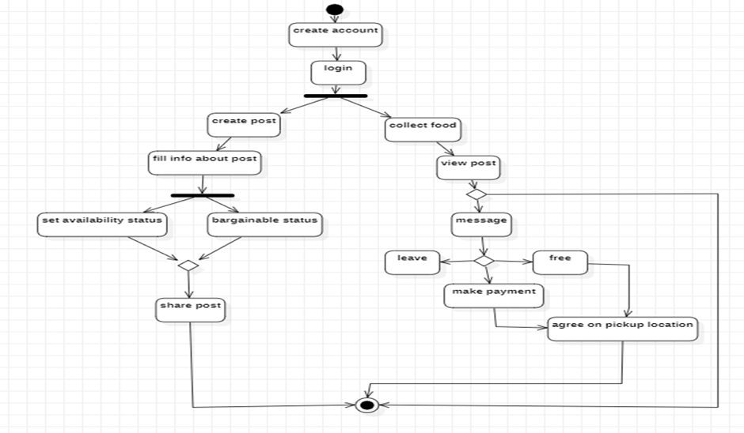
03
c- ACTIVITY DIAGRAM
To give us a behavioral view we decided to model the flow of the system in terms of the two major activities of the system in an activity diagram. Activity diagram to collect and donate food

Slide 29
03
SEQUENCE DIAGRAM
The Development of our system needs detailed description and so we try to implement most of our meaningful use cases as sequence diagrams to show the flow of each use case.

Slide 30
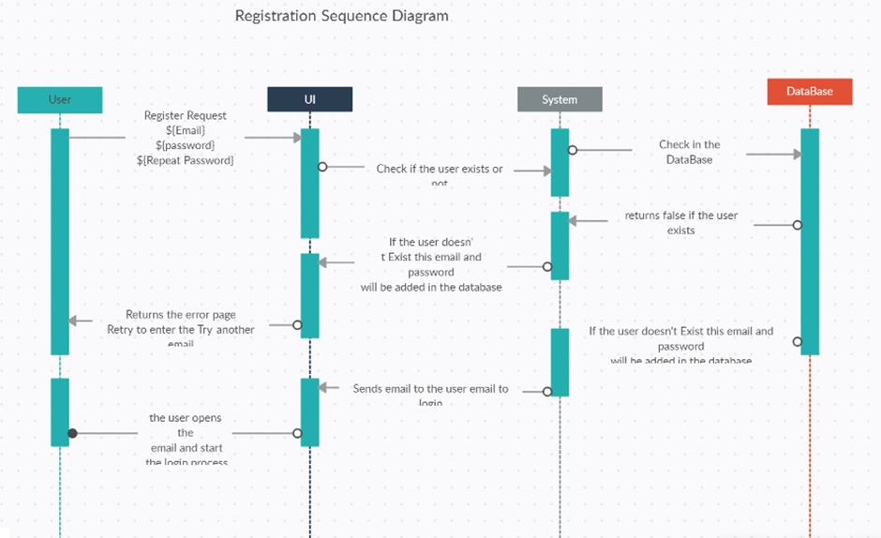
03
I- REGISTRATION SEQUENCE DIAGRAM
The sequence diagram explains the registration process of our application.

Slide 31
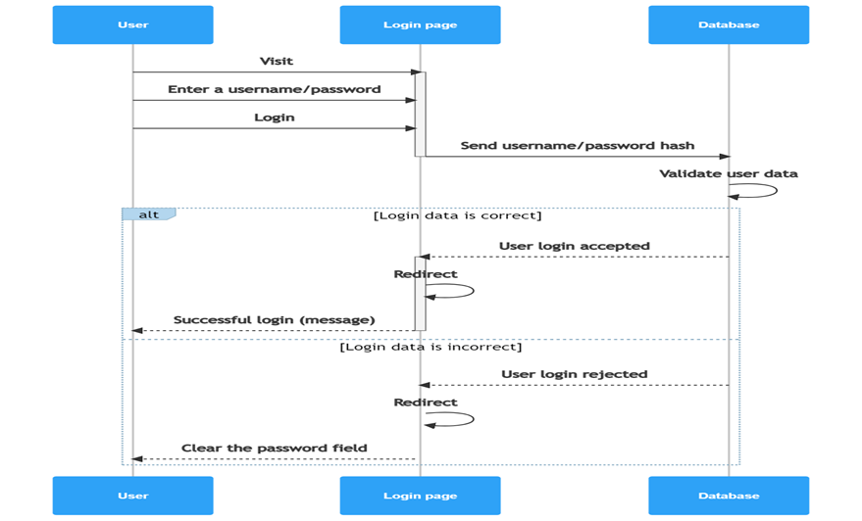
03
I- LOGIN/LOGOUT SEQUENCE DIAGRAM
This sequence diagram explains the login and logout process of our application.

Slide 32
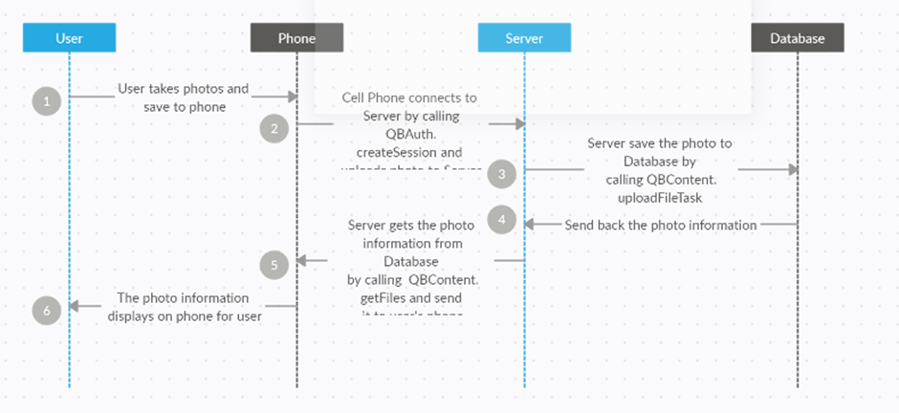
03
I- CREATE FOOD POST SEQUENCE DIAGRAM
Donors use this process to create food post in which the want to advertise or give out at an auction they can also access all options to creating the food post. Users are allowed to upload post images as explained by the following sequence diagram

Slide 33
03
5- UI DESIGN
In this phase of our project we will be looking at the UI design and implementation. This entails designing the visual layout and interaction of the application. The UI design includes a range of elements such as the color scheme, icons, buttons, menus and other visual components.
UI DESIGN CRITERIA
In order to come out with the UI design there are various criteria that need to be taken into consideration.
-Colors
-Fonts
-Page size
-Device type
-Number of pages

Slide 34

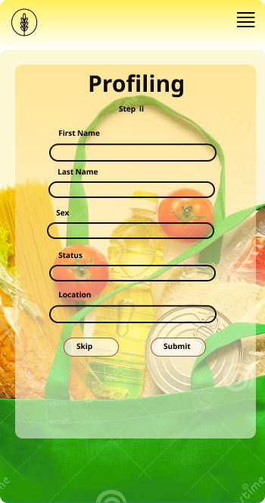
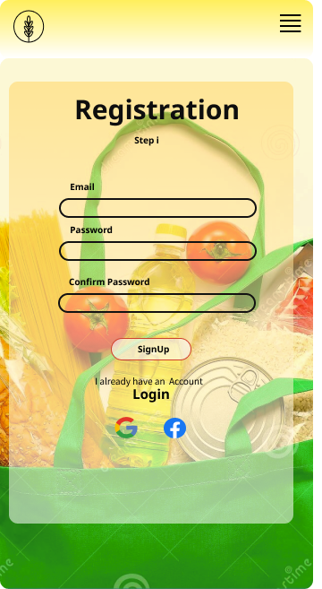
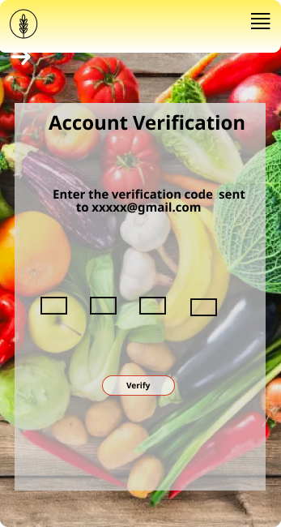
SCREENS: There are various screens in our system which includes

Slide 35
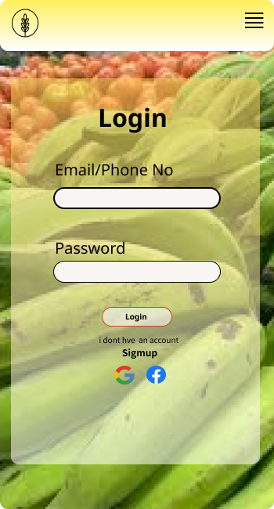
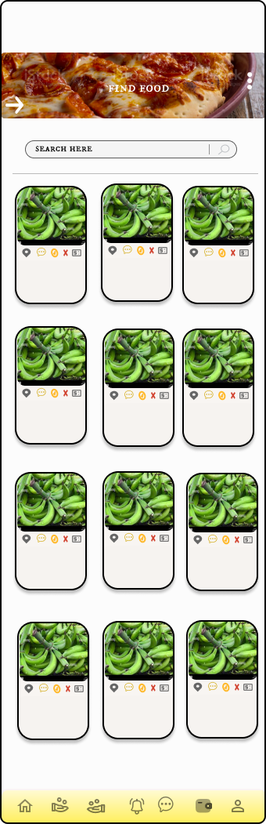
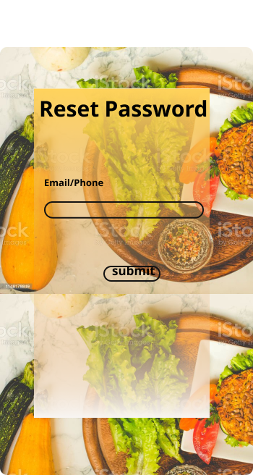
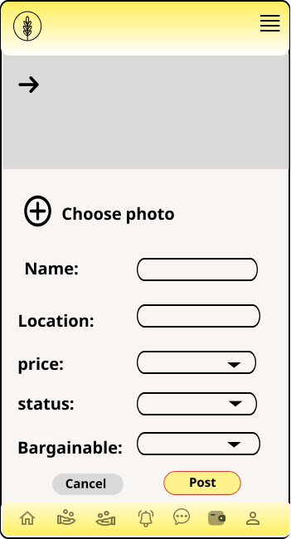

Slide 36
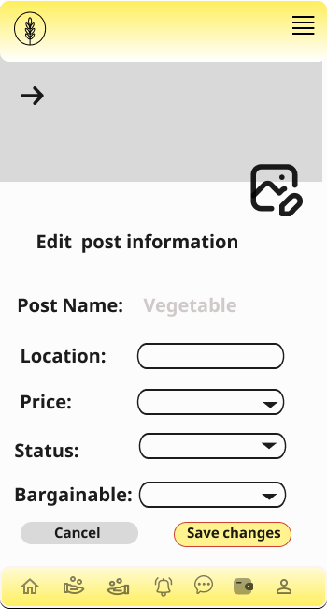
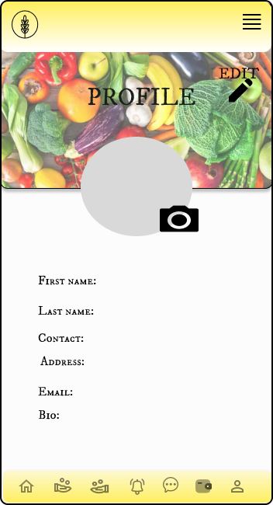
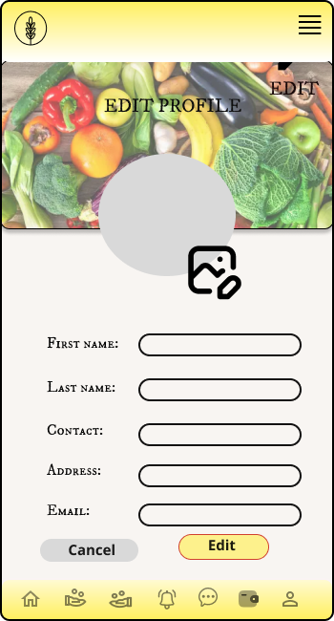
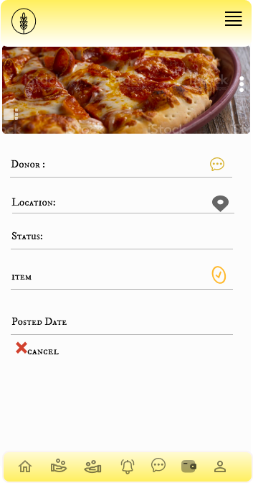

Slide 37
03
6- DATABASE DESIGN
Database design is a collection of steps that help create, implement, and maintain a business's data management systems. The primary purpose of designing a database is to produce physical and logical models of designs for the proposed database system. In order to design a database for our food waste management system (FoodAuc) some relevant information is based under different categories of Database concepts.

Slide 38
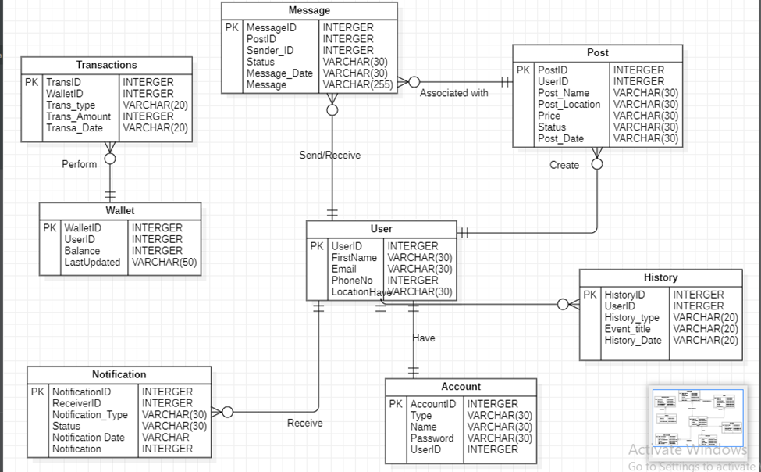
03
I- ENTITY RELATIONSHIP DIAGRAM
An entity-relationship diagram, or ER diagram, is essential for modeling the data stored in a database. Below illustrates the ER diagram of our system

Slide 39
03
2- RELATIONAL SCHEMA
A relational schema is a set of relational tables and associated items that are related to one another. There are 2 levels of the Relational schema.
I- Logical or conceptual level
II- Physical schema

Slide 40
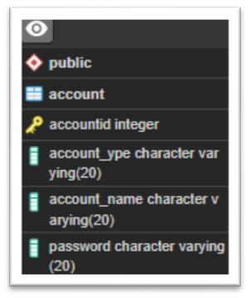
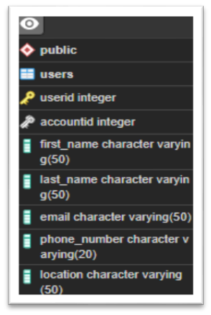
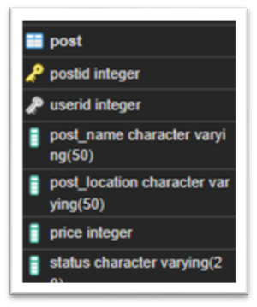
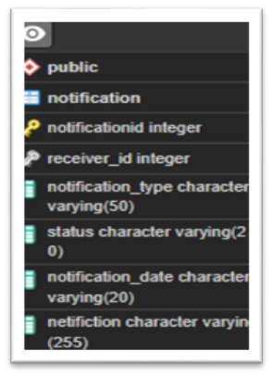
03
1- Logical or conceptual level
How users interpret the relation schemas and the meaning of their attributes.

Slide 41
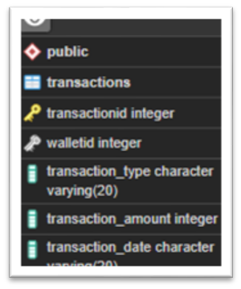
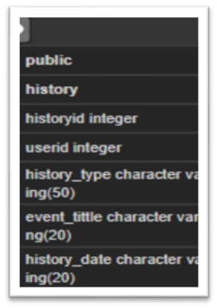
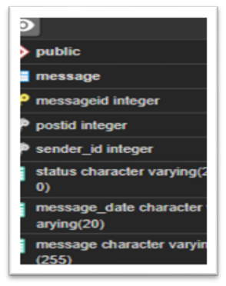
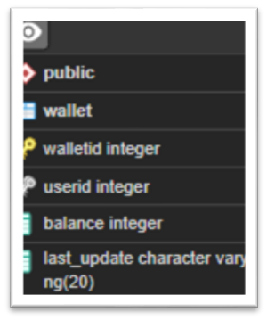
03

Slide 42
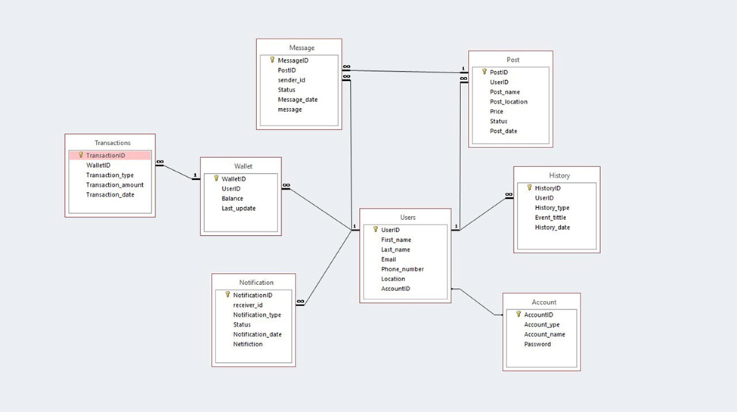
03
2- Physical schema
Physical schema is a term used in data management to describe how data is to be represented and stored (files, indices, et al.) in secondary storage using a particular database management system (DBMS). Below shows the physical schema being used for the FoodAuc application.

Slide 43
03
DESCRIPTION
The logical schema of our system incorporates several different tables
-Account table
-User table
-Post table
-Message Table
-Wallet
-History
-Transaction
-Notification

Slide 44
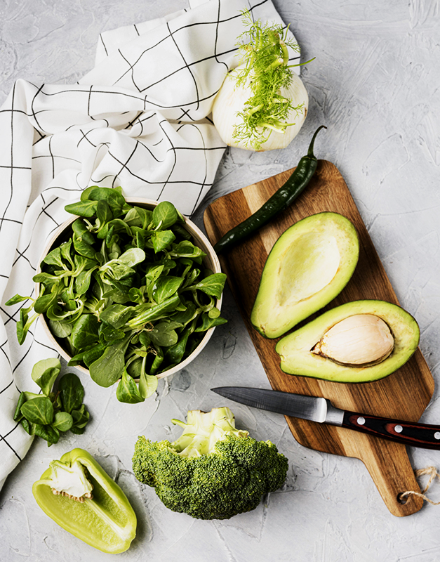
CHAPTER 4
IMPLEMENTATION (or REALIZATION) AND RESULTS

Slide 45
04
1- INTRODUCTION
Implementation refers to the process of putting a plan or idea into action. In the context of software development, implementation typically involves writing code to create a software product or feature. A well-designed and well-implemented software product is more likely to produce positive results, such as increased efficiency, improved user experience, or higher customer satisfaction.
2- TOOLS AND MATERIALS
We made use of front end and back end tools. For the front end we used Kotlin, Java, model support and XML for structuring. The technologies used for back end are SQL and firebase.
The installation and setup was done using Android studios, canvas and starUml.

Slide 46
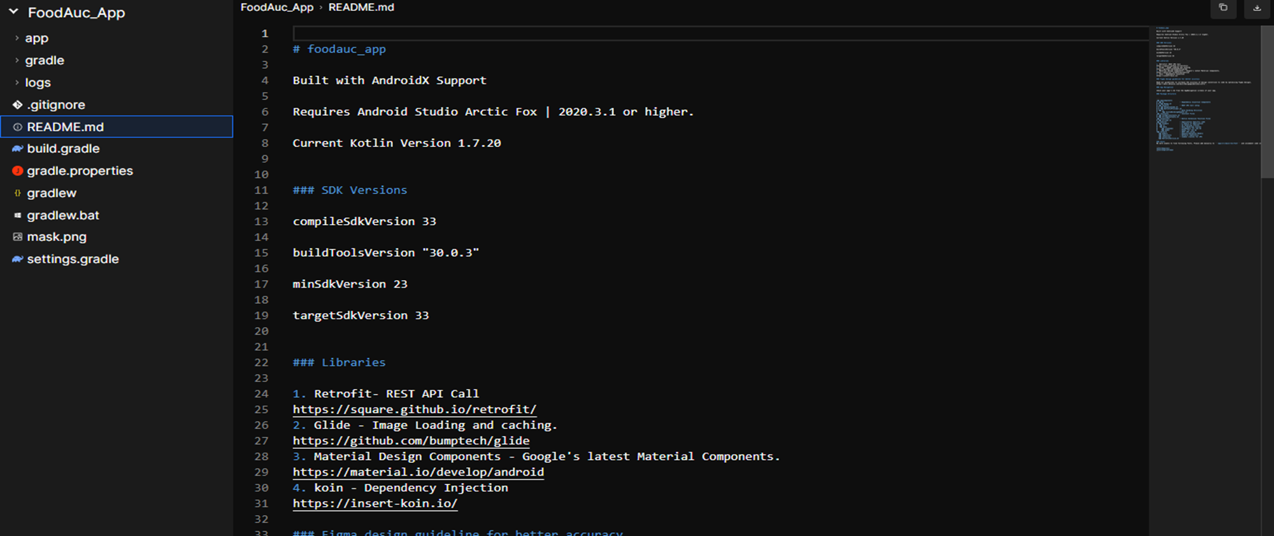
04
DESCRIPTION OF THE IMPLEMENTATION PROCESS
UI IMPLEMENTATION
For our implementation we are going to use kotlin class and model support and XML for structuring this is the structure of our application file.

Slide 47
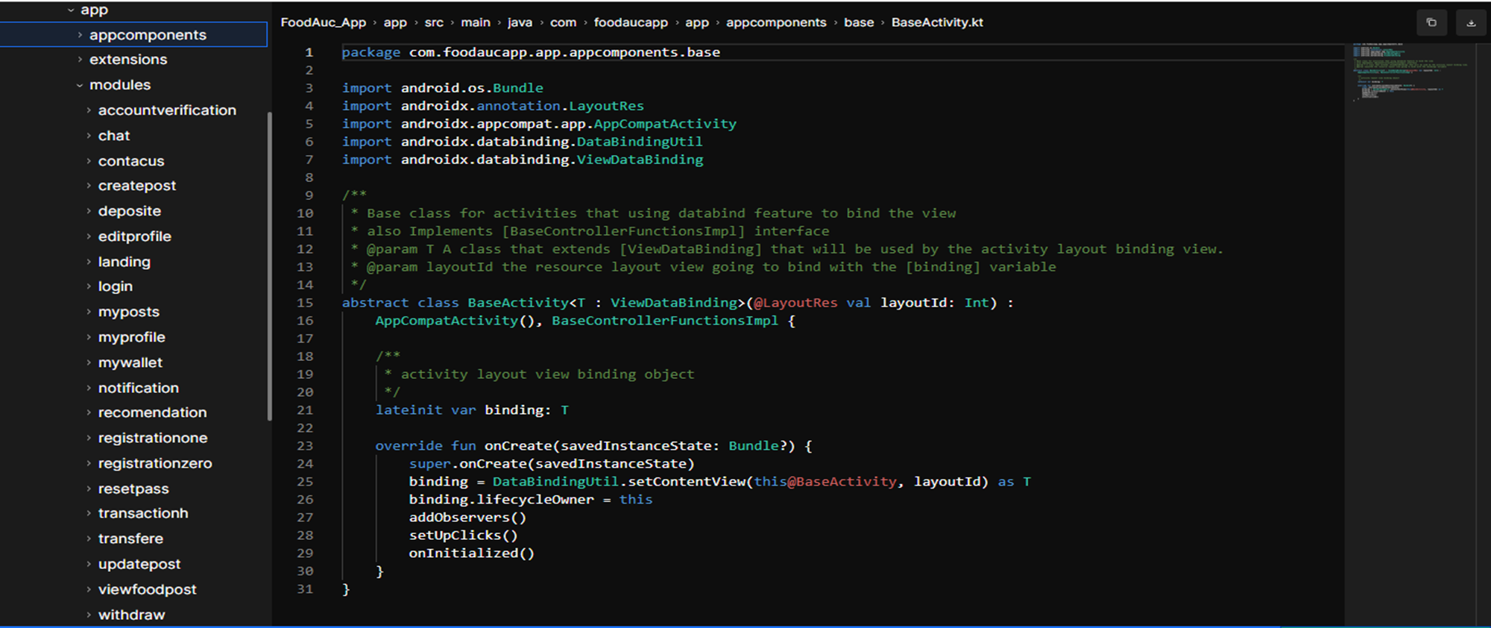
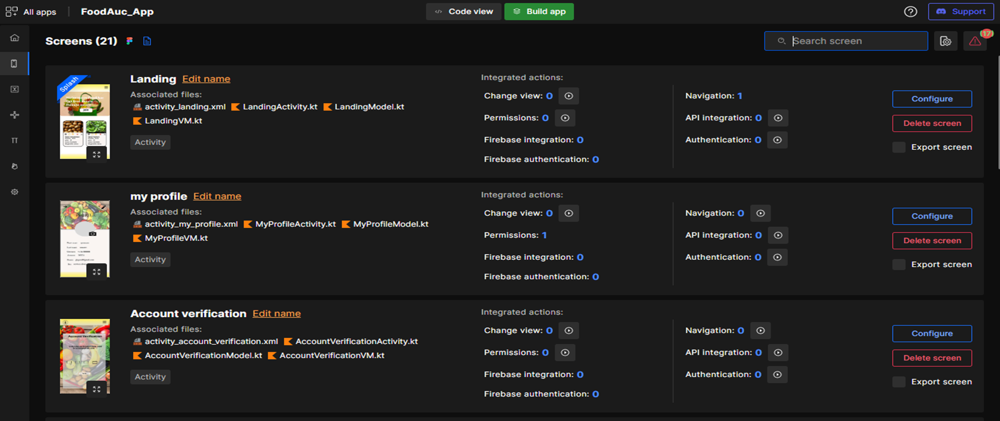
04
Here are all the models developed , our system comes with 30 pages which we model as different models.

Slide 48
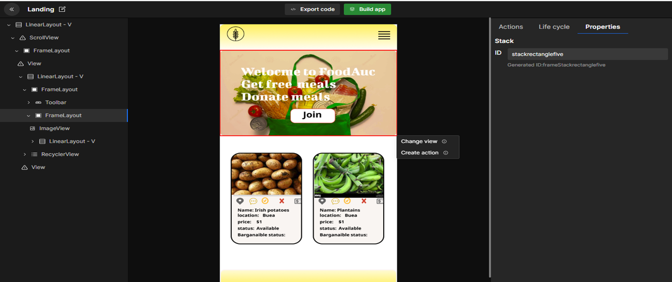
04
Modify and edit screen actions

Slide 49
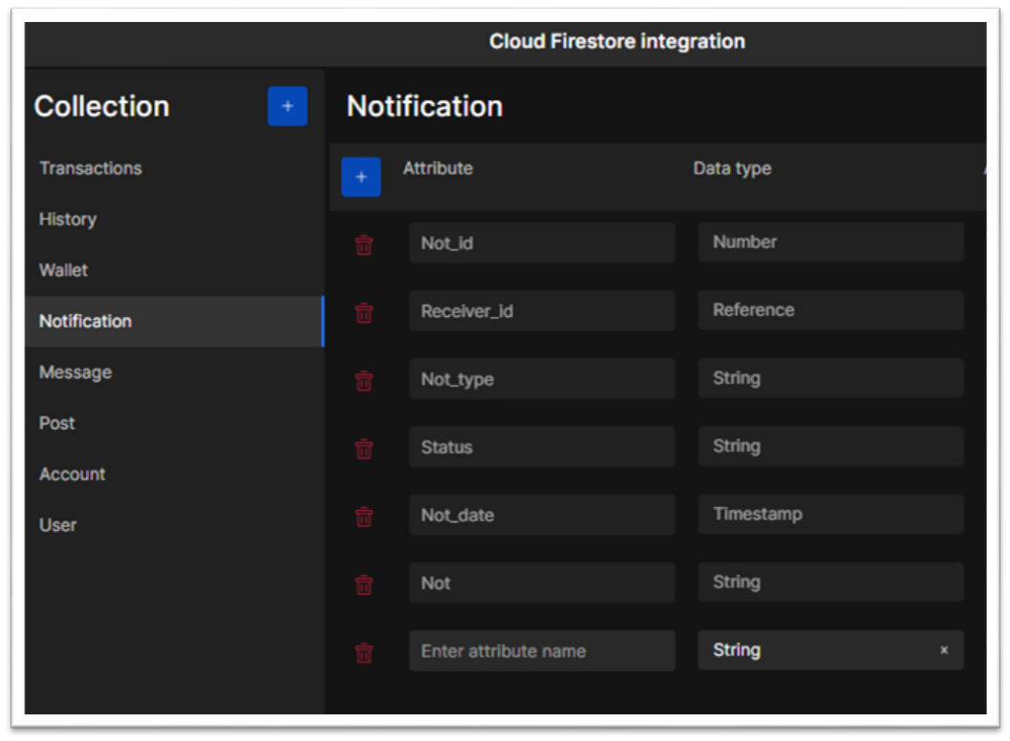
04
b- DATABASE IMPLEMENTATION
Our database is implemented on a cloud server called cloud firestore. The process an integration process. The tables are created in collections and specify constraints.

Slide 50
04
PRESENTATION AND INTERPRETATION OF RESULTS
There are several benefits of our food waste management system both for individuals and for society as a whole. Here are a few potential benefits:
-Reduce Food waste
-Cost saving
-Improve food security

Slide 51
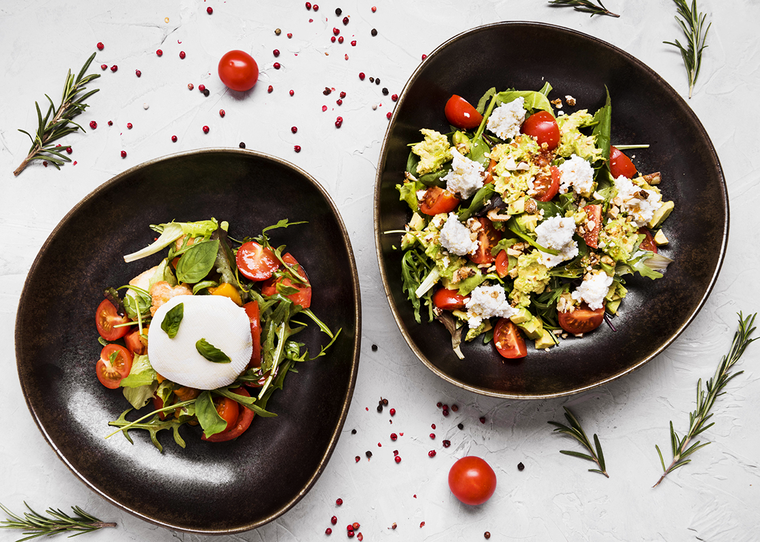
CHAPTER 5
CONCLUSION AND FURTHER WORKS

Slide 52
05
SUMMARY AND FINDING
In this report, we have presented an analysis and design of a food auctioning system, and described the implementation and evaluation of the system. The objectives of the system were to provide a platform for buyers and sellers to participate in food auctions and to ensure fair prices for both parties. Based on the findings from the implementation and evaluation, the system has been found to be effective in meeting these objectives.
Based on these findings, we recommend that the system be further developed and improved to enhance its functionality, usability, and performance. Some potential areas for future work include adding more features such as real-time bidding and improving the bidding process to make it more intuitive for users.

Slide 53
05
In conclusion, the food auctioning system is an effective solution for the needs of individuals . The system's architecture, technology stack, and user interface have been designed and implemented to meet the system's objectives, and the system's performance, security, and usability have been found to be satisfactory. With further development and improvement, the system has the potential to become an even more valuable tool for the population as a whole.

Slide 54
05
RECOMMENDATION
Based on the potential benefits of a food auction system, here are some recommendations for the development and implementation of such a system:
-1. Conduct a thorough needs assessment:
2. Design a user-friendly interface:
3-. Build in scalability and flexibility:
-

Slide 55
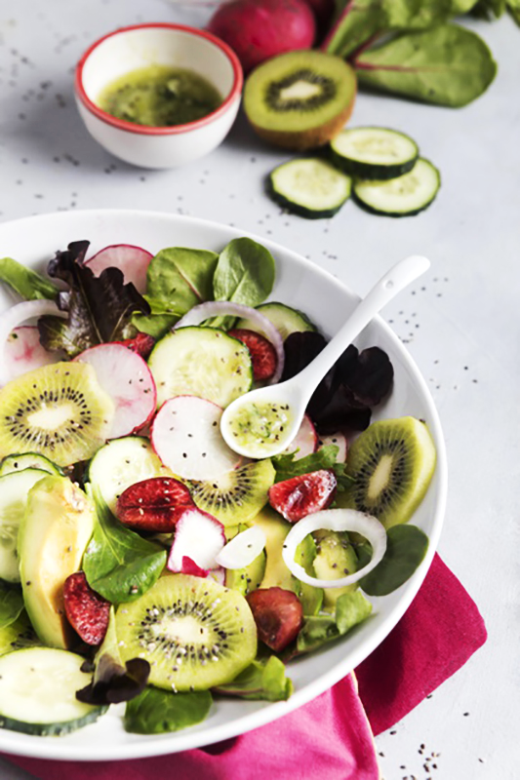
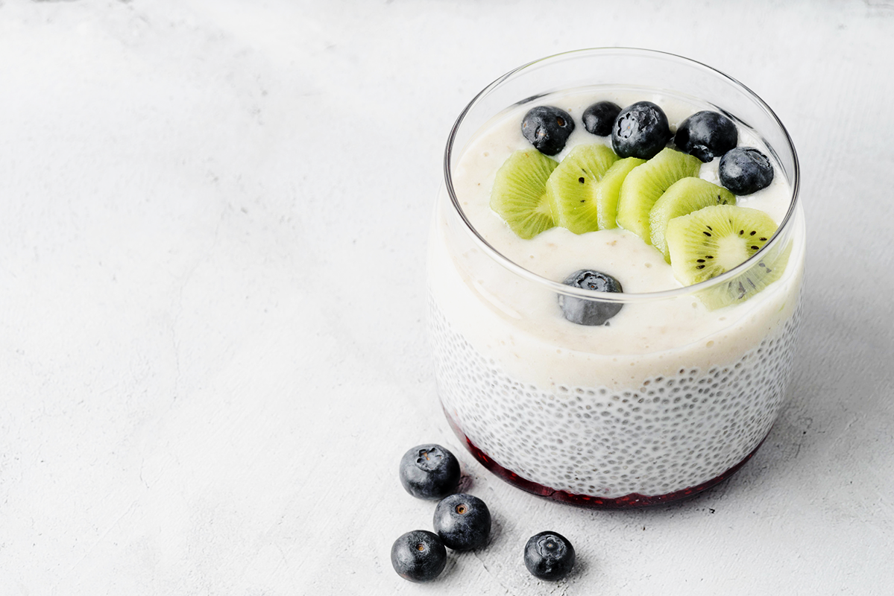
PROBLEMS
Code translation
slow
-We had problems translating the front end to code so we used a middleman setup called DhiWise
-We encountered problems in deploying the application on Android studio because Android studio was slow and might exceed runtime before the application can load.
Financial problems
-Financial problems like money for data

Slide 56
Use our editable graphic resources...
You can easily resize these resources without losing quality. To change the color, just ungroup the resource and click on the object you want to change. Then, click on the paint bucket and select the color you want. Group the resource again when you’re done. You can also look for more infographics on Slidesgo.

Slide 59
JANUARY
FEBRUARY
MARCH
APRIL
MAY
JUNE
PHASE 1
Task 1
Task 2
PHASE 2
Task 1
Task 2
JANUARY
FEBRUARY
MARCH
APRIL
PHASE 1
Task 1
Task 2

Slide 62
...and our sets of editable icons
You can resize these icons without losing quality.
You can change the stroke and fill color; just select the icon and click on the paint bucket/pen.
In Google Slides, you can also use Flaticon’s extension, allowing you to customize and add even more icons.

Slide 63
Educational Icons
Medical Icons

Slide 64
Business Icons
Teamwork Icons

Slide 65
Help & Support Icons
Avatar Icons

Slide 66
Creative process Icons
Performing Arts Icons

Slide 67
Nature Icons

Slide 68
SEO & Marketing Icons

Slide 69


